Slide 1
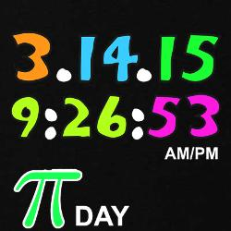
The $π$ Challenge
Using the digits 3 1 4 1 5 try to make as many whole numbers between 1 and 100 as possible
You may use any operations ($+ − × ÷ !…$ ) but each of the five numbers must appear once only

